Slide 1
Projectile Motion of a Cannon Shell
Eric LeVally
Pacific University

Slide 2
The Project
Cannon fired at different angles
Same initial velocity
Without air resistance
With air resistance
Head and tail winds

Slide 3

Equations Without Air Resistance
$x_{i+1}=x_{i}+v_{x,i}∗ ∆t$
$v_{x,i+1 }=v_{x,i}$
$y_{i+1}=y_{i}+v_{y,i}∗ ∆t$
$v_{y,i+1}=v_{y,i}−g∗ ∆t$

Slide 4
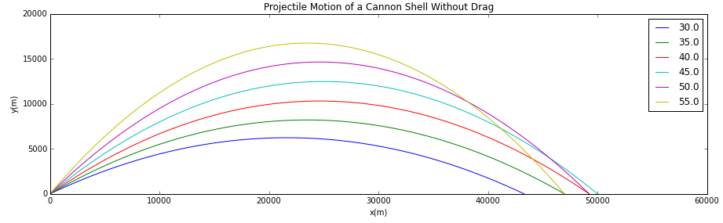
Without Drag
Optimal angle
Constant x velocity
Constant downwards acceleration

Slide 5
Drag
Mechanical Force
Interaction and contact of a solid body with a fluid force
Generated by difference in velocity

Slide 6

Equations With Air Resistance
$x_{i+1}=x_{i}+v_{x,i}∗ ∆t$
$v_{x,i+1 }=v_{x,i} − \frac{B_{2} }{m}∗\left(v∗v_{x,i }\right)∗∆t$
$y_{i+1}=y_{i}+v_{y,i}∗ ∆t$
$v_{y,i+1}=v_{y,i}−g∗ ∆t −\frac{B_{2} }{m}∗\left(v∗v_{x,i }\right)∗∆t$
Drag is a force

Slide 7
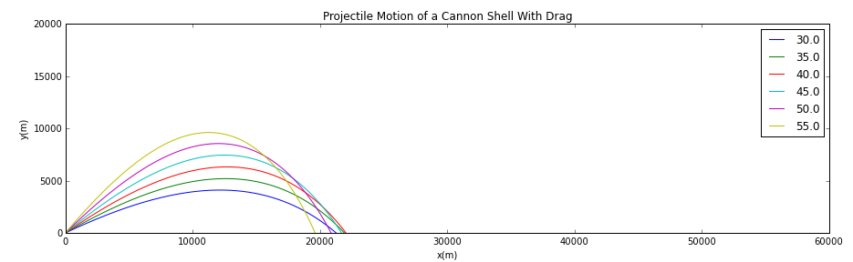
With Drag
Optimal Angle
Fire into the wind
Non constant x velocity

Slide 8
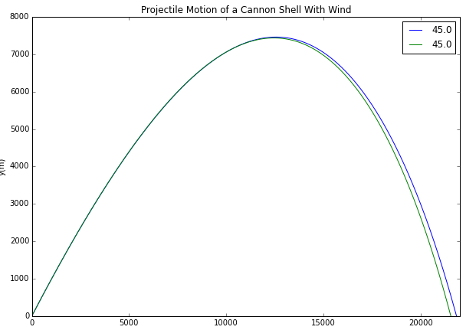
With Head and Tail Winds
The scale
Missing is missing

Slide 9
References
Drag of a Sphere. NASA Available at: https://www.grc.nasa.gov/www/k-12/airplane/dragsphere.html. (Accessed: 8th March 2018)
What is Drag?. NASA May 5 2015. Available at: https://www.grc.nasa.gov/www/k-12/airplane/drag1.html (Accessed: 8th March 2018)

